Slide 1




MS
PowerPoint
Class V
lab 21

Slide 2

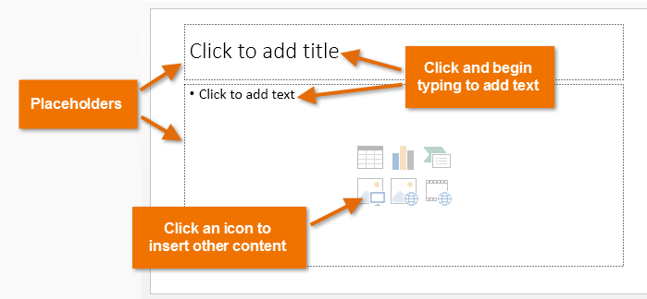
Placeholders
In Microsoft PowerPoint, placeholders are boxes with dotted borders that contain content and reside within a slide layout

Slide 3
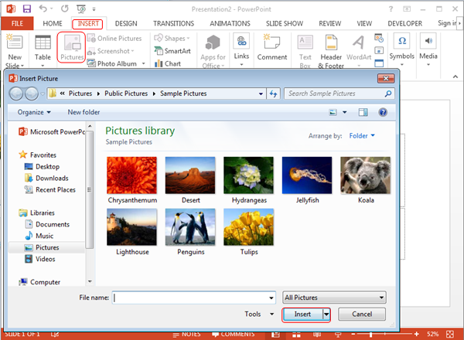
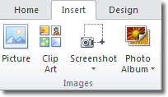
Inserting Images
To insert an image in PowerPoint, click Insert > Images

Slide 4
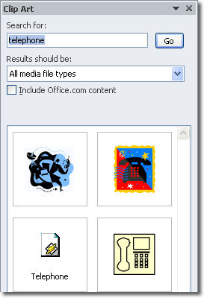
Insert Clip Art
When you click the Clip Art button, the Clip Art panel opens on the right of the workspace, choose one and use on your presentation

Slide 5


